Slide 1
Wanderwise
Sprint 1 Review & Sprint 2 Planning
Personalized travel.
Realistic daily plans.
Project design • Sprint 1 evidence & metrics
Retrospective • Sprint 2 planning • Application demonstration
CS-691 | Fall 2026 | Team F2026-Team4
Wanderwise | CS-691 | Team F2026-Team4 | Sprint 1
01

Slide 2
UPDATED
Agenda
Approved sequence, with restored story coverage and actual application screenshots.
01 Project & team
Team photos and roles, feedback improvements, description, and working agreement.
02 Product & design
Three personas, MVP scope, technologies, algorithms, and six system diagrams.
03 Sprint 1 evidence
Product backlog, user stories, sprint backlog, tasks, tests, statuses, and metrics.
04 Next steps & demonstration
Retrospective, two-slide Sprint 2 plan, actual screenshots, API evidence, and live demo.
Wanderwise | CS-691 | Team F2026-Team4 | Sprint 1
02

Slide 3



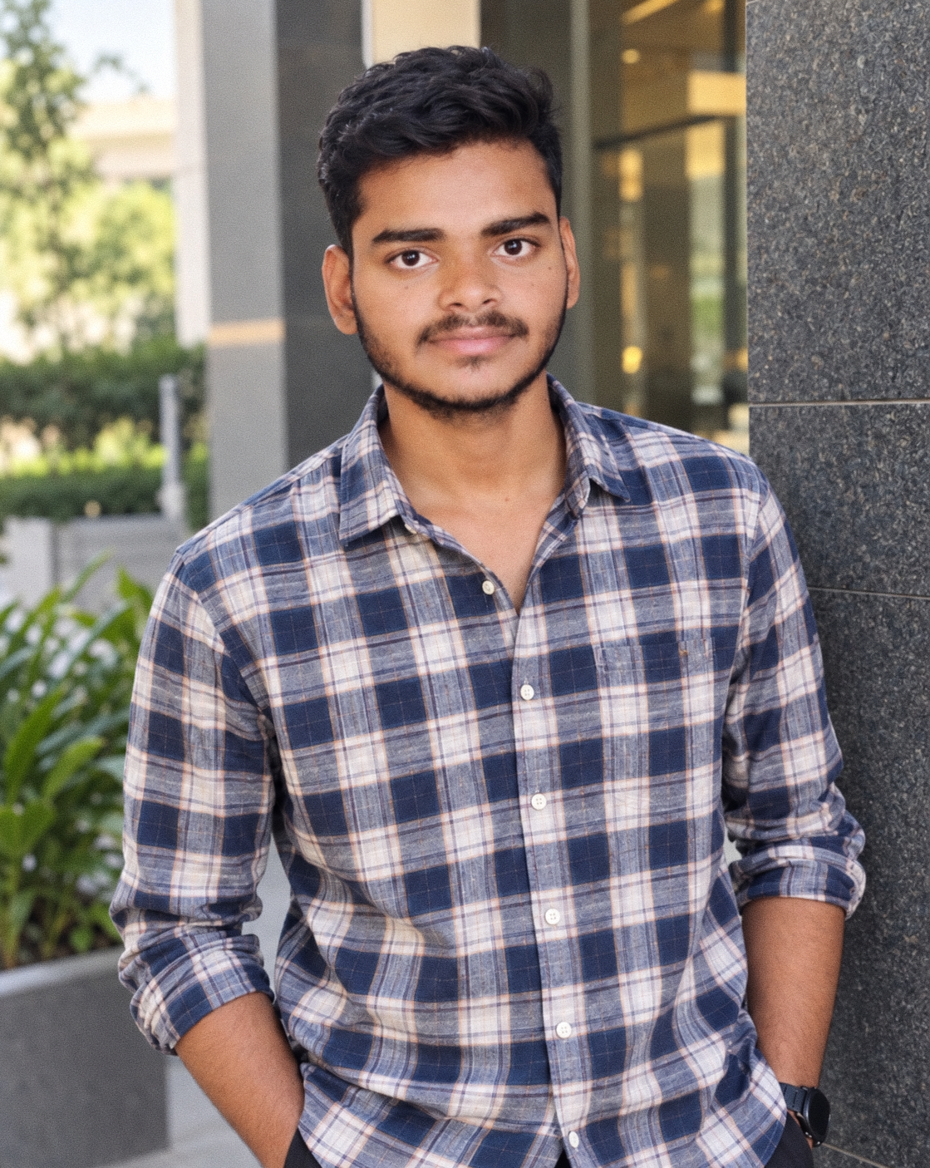

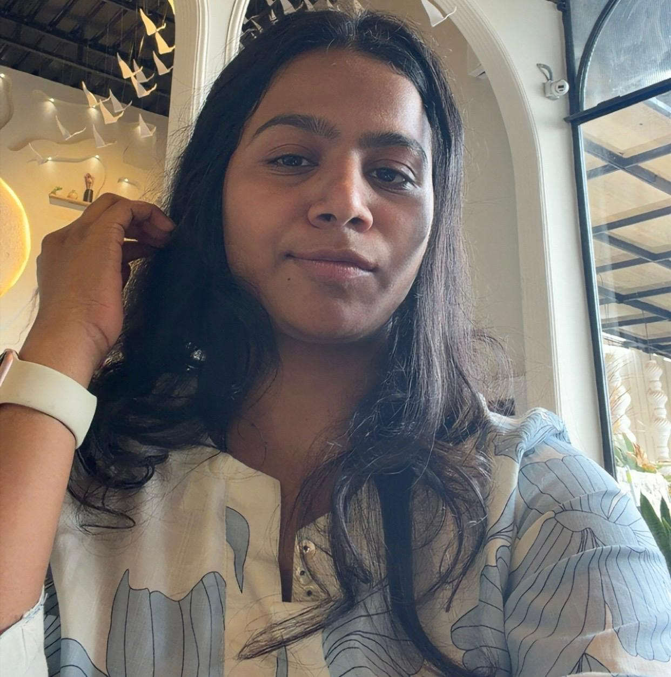
UPDATED
TEAM MEMBERS — ROLES & RESPONSIBILITIES
WanderWise | CS-691 | Team 4 | Sprint 1
Syed Ali Ghazi
Sidhartha Boddupally
Ramu Kommu
Team Lead • Product Owner
Model & Ranking
Optimizer
Backend / LLM / AI
Developer
Scoring & Scheduling
Bala Ravi Raja Polisetty
Sushma
K. Srija
Integration & Testing
Data Processing
Scrum Master • Developer
Confidence & Cleaning
Frontend & Sprint Coordination
Wanderwise | CS-691 | Team F2026-Team4 | Sprint 1
03

Slide 4
UPDATED
Improvements from Professor Feedback
Changed slides are marked UPDATED; references below match this revised deck.
Feedback theme | Presentation response / reference
Clear speaking roles | Roles and photos: slide 3. Assign speakers during rehearsal.
One aligned plan | MVP: 10; backlogs and stories: 19–23; Sprint 2 plan: 31–32.
Visible teamwork | Original team-photo layout: 3. Confirm cameras and participation in recording.
Evidence over agreement | Task evidence: 23; tests: 24; metrics: 27–29. Record decisions, owners, dates, and blockers.
Demonstrate working progress | Show reported outcomes and gaps: 25–26; screenshots: 33–34; live demo: 37.
Wanderwise | CS-691 | Team F2026-Team4 | Sprint 1
04

Slide 5
UPDATED
Wanderwise | Project Description
Personalized, day-by-day travel planning
Project Name | Wanderwise
Team | F2026-Team4
Project Description | For travelers planning their own trips, who spend hours comparing scattered travel information, the Wanderwise web application is a personalized itinerary planner that builds daily plans around preferences, time, and budget. Unlike generic guides and fixed tours, our application personalizes stops and flags unverified details.
Benefit Outcomes | Expected: less planning time; visible stop and trip costs; recommendation reasons and confidence scores; clear uncertainty warnings.
GitHub Wiki | https://github.com/htmw/F2026-Team4/wiki
Wanderwise | CS-691 | Team F2026-Team4 | Sprint 1
05

Slide 6
UPDATED
HOW WE WORK
Team Working Agreement
Communication
Online Meetings
WhatsApp for day-to-day updates, questions, and coordination.
Zoom for sprint planning, progress, and problem-solving.
In-Person
GitHub
Face-to-face when we need hands-on group work.
Branch → PR → review → merge; everyone contributes.
Accountability
Collaboration
Own your tasks; commit work ≈ 48h early, not an hour before.
Support each other on integration and testing; we remind, no offense taken.
Wanderwise | CS-691 | Team F2026-Team4 | Sprint 1
06

Slide 7

UPDATED
PERSONA 1
Budget-Conscious Student Traveler
“I want to explore the city without exceeding my budget or wasting time between places.”
GOALS
FRUSTRATIONS
Stay within a fixed trip budget
Still see the important attractions
Cut travel time between stops
Generic plans suggest costly activities
Recommended places are far apart
Prices and hours are often outdated
Arjun Mehta
Budget-Conscious Student Traveler
Age: 24
Education: MSc Computer Science (in progress)
Hometown: Pune, India
Family: Single
Occupation: Grad student & part-time TA
What our app must provide: Budget-aware ranking · Verified hours & costs · Walking limit
Arjun travels between semesters on a tight budget. He researches for hours across blogs and maps but still ends up backtracking and overspending. He wants a plan that respects his budget and keeps each day efficient, so he sees more with less stress.
Wanderwise | CS-691 | Team F2026-Team4 | Sprint 1
07

Slide 8

UPDATED
PERSONA 2
Parent Planning a Family Vacation
“I want my family to enjoy the trip without rushing, walking too much, or missing breaks.”
GOALS
FRUSTRATIONS
Find activities for kids and adults
Keep each day comfortable and flexible
Reduce travel between attractions
Generic plans pack in too many activities
Kids get tired on long walks
One delay derails the whole day
Sarah Johnson
Parent Planning a Family Vacation
Age: 38
Education: BBA, Marketing
Hometown: Chicago, USA
Family: Married, two kids (7 & 10)
Occupation: Marketing manager
What our app must provide: Family-friendly filters · Meal & rest breaks · Easy re-planning
Sarah plans the family's one big trip each year, juggling two kids with different energy levels and a partner who hates rushing. She needs a realistic, flexible plan with built-in breaks that she can adjust on the fly when the day runs late.
Wanderwise | CS-691 | Team F2026-Team4 | Sprint 1
08

Slide 9

UPDATED
PERSONA 3
Traveler with Limited Mobility
“I need to know my itinerary is physically manageable before I begin the trip.”
GOALS
FRUSTRATIONS
Visit historical & cultural sites
Avoid long walks and rushed days
Get dependable accessibility details
Generic plans assume long walking ability
Accessibility information is often missing
Crowded schedules cause exhaustion
Michael Thompson
Traveler with Limited Mobility
Age: 63
Education: B.Ed, History
Hometown: Manchester, UK
Family: Married
Occupation: Retired secondary-school teacher
What our app must provide: Accessibility filters · Shorter routes & rest time · Confidence warnings
Michael loves history and museums, but a knee condition limits how far he can walk in a day. He avoids booking trips because he can't tell in advance whether a plan will be manageable. He needs walking limits respected and honest warnings when accessibility data is uncertain.
Wanderwise | CS-691 | Team F2026-Team4 | Sprint 1
09

Slide 10
UPDATED
Minimum Viable Product | Scope & Reality
Target: one traveler can create, understand, and revise a usable itinerary for Lisbon.
01
02
03
Set trip preferences
Build a feasible plan
Review and revise
Dates, interests, pace, budget, walking limits, and dietary choices.
Rank Lisbon places and schedule visits around real constraints.
Show times, costs, reasons, warnings, and support feedback.
SPRINT 1 EVIDENCE
NOT YET COMPLETE
Form and sample itinerary shown.
Saved-trip / feedback API checks pass.
Synthetic ranking results available.
Stub UI: travel, hours, budget not enforced.
Live-data / optimizer integration unfinished.
Traveler feedback UI not yet built.
Wanderwise | CS-691 | Team F2026-Team4 | Sprint 1
10

Slide 11
Technologies
TECH STACK
All free and open source, with nothing paid in the critical path.
Languages
Backend & API
Machine learning & data
Python 3.11
TypeScript
FastAPI · uvicorn · Pydantic
JSON Schema contract checks
SQLite for saved trips (new)
LightGBM learning-to-rank · NumPy
OpenStreetMap + Overpass (in review)
Frontend
LLM
Dev, CI & testing
React
Vite
Ollama, local model (planned)
GitHub Actions CI · uv · make
ruff · pytest · vitest
Wanderwise | CS-691 | Team F2026-Team4 | Sprint 1
11

Slide 12
Algorithms
THE ALGORITHMS
The LLM never plans the trip. A trained ranker and a deterministic scheduler do.
Learning-to-rank
Itinerary optimization
Distance & routing
LightGBM LambdaRank. NDCG@5 on held-out travelers, higher is better:
Greedy day packing today; constraint-aware optimizer in review.
Haversine × 1.3 at 4.5 km/h walking. OSRM check pending.
Trained model
0.958
Hand-coded scorer
~0.93
Popularity
0.532
Feedback re-planning
Preference extraction
Random
0.532
Rejected places are dropped and the trip is re-planned (new).
LLM turns free text into a validated profile (planned).
Synthetic travelers in Sprint 1; real data in Sprint 2.
Wanderwise | CS-691 | Team F2026-Team4 | Sprint 1
12

Slide 13
SPRINT 1 | WANDERWISE
Architecture diagram | planned end-to-end flow
1. User interface
React + TypeScript
preferences & itinerary
2. API layer
FastAPI
request / session state
3. Preference & ranker
Structured profile
candidate scoring
4. Optimizer
Select + order activities
respect constraints
5. Itinerary output
Day-by-day plan
with explanations
Data ingestion
Conversation updates
Important boundary
Curated places, opening hours,
coordinates and travel times
User asks for changes; profile
and itinerary are revised
LLM supports language; optimizer
owns schedule selection
Wanderwise | CS-691 | Team F2026-Team4 | Sprint 1
13

Slide 14
SPRINT 1 | WANDERWISE
Context diagram | system boundary
Places data
Attractions, hours,
location details
Wanderwise planner
Profile extraction • place ranking
schedule optimization • explanations
Traveler
Destination, dates,
preferences, budget
Travel-time data
Estimated travel between
candidate places
LLM service
Parse preferences and
explain recommendations
Wanderwise | CS-691 | Team F2026-Team4 | Sprint 1
14

Slide 15
SPRINT 1 | WANDERWISE
ER diagram | data relationships
TRIP
trip_id (PK)
destination, dates, budget
TRAVELER_PROFILE
profile_id (PK)
preferences, constraints
ITINERARY_DAY
day_id (PK)
trip_id (FK), date
PLACE
place_id (PK)
name, category, hours
SCHEDULED_STOP
stop_id (PK)
day_id (FK), place_id (FK)
Wanderwise | CS-691 | Team F2026-Team4 | Sprint 1
15

Slide 16
SPRINT 1 | WANDERWISE
Sequence diagram | generate an itinerary
Traveler
Frontend
API
Ranker + optimizer
Place / travel data
Submit trip preferences
POST trip request
Build structured profile
Fetch candidate places / times
Return scheduled plan
Wanderwise | CS-691 | Team F2026-Team4 | Sprint 1
16

Slide 17
SPRINT 1 | WANDERWISE
State diagram | itinerary lifecycle
Draft request
Preferences
structured
Candidates
ranked
Schedule
optimized
Itinerary
presented
If data or constraints are missing
If the user requests a change
Ask a clarifying question or flag unavailable information; do not silently assume.
Update the request/profile and re-run ranking or scheduling for the affected plan.
Wanderwise | CS-691 | Team F2026-Team4 | Sprint 1
17

Slide 18
SPRINT 1 | WANDERWISE
Class diagram | core domain model
TravelerProfile
budget • interests • pace
accessibility • constraints
TripRequest
destination • start/end date
trip length • budget
Place
category • location • cost
opening hours • duration
TravelLeg
from • to • duration
mode / distance
Itinerary
days • selected activities
budget summary
ScheduledActivity
place • day • start/end
score • sequence
Wanderwise | CS-691 | Team F2026-Team4 | Sprint 1
18

Slide 19
UPDATED
Product Backlog | Status After Sprint 1
Product-level statuses are reported in the source; they are not verified TS/US story closures.
# | Product backlog item | Status | Evidence / limitation
1 | Enter trip details | Done | Validated form; one blank-time defect remains
2 | Build traveler profile | Partly done | Form exists; free-text LLM not started
3 | Retrieve city places | In review | Lisbon data; live ingest in review
4 | Rank places with a model | Done | Synthetic evaluation; real-data training next
5 | Build a feasible daily plan | In review | Stub UI scheduler; optimizer in review
6 | Display itinerary & reasons | Done | Sample plan displays times, costs, reasons
7 | Adjust plan from feedback | Partly done | API exists; feedback UI not yet built
8 | Save and reload trips | Done | SQLite storage; retrieval by trip ID
Wanderwise | CS-691 | Team F2026-Team4 | Sprint 1
19

Slide 20
UPDATED
User Stories | Sprint 1
The two user-story IDs from the committed Sprint 1 backlog; technical stories follow.
US-01 | Preference form & input validation | 5 points
As a traveler, I want to enter and validate my destination, dates, and interests so that my trip request can be sent to the planner.
Acceptance: destination, dates, and interest inputs are validated; a valid request reaches the planning API.
US-02 | Itinerary display improvements | 3 points
As a traveler, I want a readable daily itinerary so that I can understand my stops, schedule, costs, and recommendations.
Acceptance: the daily itinerary displays stops, start/end times, cost, and recommendation details.
Wanderwise | CS-691 | Team F2026-Team4 | Sprint 1
20

Slide 21
UPDATED
Sprint 1 Backlog | 1 of 2
Seven committed stories / technical tasks • 35 story points total
ID | Committed story / technical task | Acceptance criteria | Points
TS-01 | Data collection, preprocessing & ingestion pipeline | Lisbon records collected and cleaned; required fields documented; ingestion output validated against place schema. | 8
TS-02 | Travel itinerary optimization & scheduling | Scheduler produces valid day-by-day plan while enforcing travel time, opening hours and constraints. | 8
US-01 | Travel preference form & input validation | Destination, dates and interest inputs validated; valid request reaches planning API. | 5
US-02 | Frontend UI & itinerary display improvements | A readable daily itinerary displays stops, start/end times, cost and recommendation details. | 3
The separate User Stories slide does not add points or duplicate commitment totals.
Wanderwise | CS-691 | Team F2026-Team4 | Sprint 1
21

Slide 22
UPDATED
Sprint 1 Backlog | 2 of 2
Seven committed stories / technical tasks • 35 story points total
ID | Committed story / technical task | Acceptance criteria | Points
TS-03 | Backend, saved trips & feedback re-planning | Planning endpoint returns valid itinerary; saved trip retrieved by ID; rejected places excluded upon re-plan. | 5
TS-04 | Frontend, backend & integration testing | Automated component tests run; frontend-to-backend full flow is tested and results recorded. | 5
TS-05 | Lisbon destination restriction | Requests for Lisbon are accepted; unsupported destinations are rejected or clearly limited to Lisbon. | 1
The separate User Stories slide does not add points or duplicate commitment totals.
Wanderwise | CS-691 | Team F2026-Team4 | Sprint 1
22

Slide 23
UPDATED
SPRINT 1 | WANDERWISE
Sprint 1 | stories and tasks to track
WORK AREA
SPRINT TASK / OUTCOME
EVIDENCE TO SHOW
Preference handling
Convert user inputs into a structured trip profile
Example request → parsed fields
Candidate ranking
Score places against interests, budget and trip constraints
Ranked candidates / score output
Schedule optimization
Select and order activities across available days
Generated itinerary + constraints
Data integration
Use curated place details and available travel-time / hours data
Source fields and missing-data behavior
Validation
Test key user stories and record pass/fail results
Test cases linked to story IDs
Wanderwise | CS-691 | Team F2026-Team4 | Sprint 1
23

Slide 24
Test Cases
Test Summary
Module | Total | Passed | Failed | Coverage
Frontend - Interest preferences | 2 | 2 | 0 | 100%
Frontend - Trip details and limits | 4 | 4 | 0 | 100%
Frontend - Blank daily times | 1 | 0 | 1 | 100%
Backend - Saved trips and feedback | 6 | 6 | 0 | 96%
Backend - Lisbon data processing | 7 | 7 | 0 | 92%
Backend - Ranking model | 4 | 4 | 0 | 88%
Backend - Optimizer and scheduler | 7 | 6 | 1 | 85%
TOTAL | 31 | 29 | 2 | 92%
Stack: React | TypeScript | Vite | Python | FastAPI | LightGBM
Testing: Vitest | React Testing Library | pytest | Coverage.py

Slide 25
Test Cases - Frontend
Test Case | Test Name | Test Steps | Description / Expected Result | Status
1 | Interest sliders | Move each of 7 sliders | Values change from 0.0 to 1.0 | PASS
2 | Destination | Submit empty text or spaces | Show “Please enter a destination” | PASS
3 | Travel dates | Leave either date empty | Show missing-date warning | PASS
4 | Invalid numbers | Enter negative values or walking >240 | Block values outside allowed range | PASS
5 | Daily time order | Use 6 PM–10 AM or equal times | Show time-order warning | PASS
6 | All interests zero | Set all 7 interests to 0 | Ask for at least one interest | PASS
7 | Blank daily times | Clear start or end time | Missing or misleading warning instead of a clear missing-time message | FAIL

Slide 26
Test Cases - Backend
Test Case | Test Name | Test Steps | Description / Expected Result | Status
1 | Saved-trip retrieval | Create a trip, then GET its ID | Return the saved itinerary | PASS
2 | Reject a place | Send feedback rejecting a place | Return a revised plan without it | PASS
3 | Remember rejections | Reject a second place | Keep both rejected places out | PASS
4 | Missing trip | GET or send feedback for missing ID | Return HTTP 404 | PASS
5 | Invalid feedback | Send a number instead of a list | Return HTTP 422 | PASS
6 | Separate trips | Create a new trip, GET the old one | Keep old trip and its feedback unchanged | PASS

Slide 27
Test Cases - Backend
Test Case | Test Name | Test Steps | Description / Expected Result | Status
1 | Data: Existing Python tests | Run pytest -q | All collected tests pass | PASS
2 | Data: Data loading | Load Lisbon places | 6,073 Lisbon records loaded | PASS
3 | Data: Unique record IDs | Count all IDs and unique IDs | No repeated record IDs | PASS
4 | Data: Basic fields | Check names, categories, coordinates | No missing fields in these checks | PASS
5 | Data: City alias | Compare Lisbon and Lisboa | Return identical records | PASS
6 | Data: Unsupported city | Load New York directly | Raise CityNotAvailable | PASS
7 | Data: Travel estimates | Compare walking allowance 20 vs 240 | Sample pairs change transit to walk | PASS

Slide 28
Test Cases - Backend
Test Case | Test Name | Test Steps | Description / Expected Result | Status
1 | Ranking: Existing ranking tests | Run pytest ranker/tests -q | All 3 existing tests pass | PASS
2 | Ranking: Synthetic evaluation | Run ranker.evaluate | Synthetic NDCG@5: model 0.958, rules 0.932, popularity/random 0.532 | PASS
3 | Ranking: Food preference | Food 1.0, all other interests 0 | Food venues rank near the top | PASS
4 | Ranking: Nature preference | Nature 1.0, all other interests 0 | Ranking changes toward nature categories | PASS

Slide 29
Test Cases - Backend
Test Case | Test Name | Test Steps | Description / Expected Result | Status
1 | Optimizer: Existing tests | Run general tests and scheduler file | 18 general and 8 additional tests pass | PASS
2 | Optimizer: Budget limit | Set budget to 10 EUR | Stored attraction costs total <=10 EUR | PASS
3 | Optimizer: Daily time window | Set daily hours to 12 PM–2 PM | All visits fit within the window | PASS
4 | Optimizer: Avoid and duplicates | Avoid castle, inspect returned IDs | Castle absent; no repeated IDs | PASS
5 | Optimizer: Zero walking | Set walking allowance to 0 | No positive walking travel legs | PASS
6 | Optimizer: Known opening hours | Check fit, too-long visit, closed day | Wait until open; reject infeasible visits | PASS
7 | Optimizer: Inferred-hours penalty | Change only hours confidence | Known and inferred hours both scored 0.3697. Required penalty missing | FAIL

Slide 30
UPDATED
Sprint 1 Stories | Completed
Dates intentionally omitted. Status reflects the latest project updates shared.
Workstream | Completed story / deliverable | Status
Data | DS-1 — Real Lisbon dataset (6,073 places); other cities rejected | Completed
Data | DS-2 — Hours and prices labeled known, inferred, or unknown | Completed
Data | DS-3 — Walking and transit travel-time estimates between places | Completed
Data | DS-4 — Duplicate sights merged; each sight appears once | Completed
Data | DS-5 — Popularity score added for attraction ranking | Completed
Data | DS-6 — One-command data rebuild | Completed
Data | DS-7 — Data coverage report | Completed
Data | DS-8 — Weather forecast support for rainy-day planning | Completed
Frontend | Dashboard UI improvements; sample Lisbon itinerary displayed | Completed
Frontend | PR #11 reviewed and merged into main | Merged
Platform/API | Repository setup, CI, Makefile, design docs, subfolder READMEs | Merged; CI passing
Platform/API | Data contracts, category vocabulary, Lisbon fixtures | Merged; CI passing
Platform/API | FastAPI planning, saved trips, trip retrieval, feedback/re-planning, validation | Implemented
Model & Ranking | Personalized attraction scoring and learning-to-rank recommender | Implemented
Testing | Frontend, saved-trip/feedback APIs, ranking and optimizer checks in PR #12 | Uploaded in PR #12
Testing | 191 existing tests passed in the reported test run | Passed
Wanderwise | CS-691 | Team F2026-Team4 | Sprint 1
30

Slide 31
UPDATED
Sprint 1 Stories | Not Completed / Blocked
Pending work and dependencies to carry into the next sprint
Workstream | Pending story / deliverable | Status / dependency
Data | DS-9 — Real opening hours for top sights | Planned for Sprint 2
Data | DS-10 — Real entry prices for top sights | Planned for Sprint 2
Full-stack | DS-11 — Display place names in the itinerary | Needs backend + frontend
Integration | Verify frontend connection to FastAPI with real responses | Pending verification
Frontend | Collapsible itinerary day sections | Not implemented / not confirmed
Optimizer | Resolve CI failure in optimizer PR and verify real scheduling | Blocked
Model & Ranking | Retrain ranker on real attraction data | Waiting for ingest PR merge
Model & Ranking | Integrate ML ranking scores into the scheduler | Pending
Transportation | Integrate real-time travel-time and transportation APIs | Pending
Routing | Implement advanced route optimization algorithms | Pending
LLM / Preferences | Free-text preference extraction | Not completed
LLM / Preferences | Complete planned LLM technical spike and evaluation | Not completed
Testing | End-to-end testing with all actual components connected | Waiting for runnable integrated version
Multi-city | Test cities beyond Lisbon | Blocked by data-ingestion PR merge
Data PRs | PR #8 and PR #16 | Awaiting review / merge
Note: implementation and end-to-end verification are tracked separately.
Wanderwise | CS-691 | Team F2026-Team4 | Sprint 1
31

Slide 32
UPDATED
Sprint 1 Metrics | Team Velocity
Velocity is completed story points—not issue counts, tasks, or tests.
13
story points
completed
35 committed
22 remaining
Wanderwise | CS-691 | Team F2026-Team4 | Sprint 1
27

Slide 33
UPDATED
Sprint 1 Metrics | Burndown
Remaining story points across the Sprint 1 reporting period.
Actual work remaining ends at 22 points; the ideal endpoint is 0.
Wanderwise | CS-691 | Team F2026-Team4 | Sprint 1
28

Slide 34
UPDATED
Sprint 1 Metrics | Completion Ratio
Completed / committed story points—not the percentage of tests passed.
37.1%
13 ÷ 35 story points
13 completed
22 remaining
The 29 / 31 reported test result is a separate quality measure.
Wanderwise | CS-691 | Team F2026-Team4 | Sprint 1
29

Slide 35
SPRINT 1 RETROSPECTIVE
WanderWise — What went well, what can be improved, and action items
WHAT WENT WELL
• Core platform foundation established
• Lisbon dataset and data-quality checks completed
• Frontend dashboard can display a sample itinerary
• FastAPI planning and saved-trip/feedback APIs implemented
• Learning-to-rank model trained and evaluated against baselines
• PR #11 merged; CI passing for core platform work
• 191 existing tests passed in the reported test run
WHAT CAN BE IMPROVED
• PR reviews and merges need to happen sooner
• Optimizer CI failures delayed full scheduling verification
• Frontend-to-backend integration needs end-to-end confirmation
• Current tested data coverage is limited to Lisbon
• Some tests are component-level rather than full-flow
• Ranking model currently relies on synthetic training data
ACTION ITEMS
• Fix optimizer CI failures and validate scheduling constraints
• Review and merge data-ingestion PRs
• Retrain ranking model with real attraction data
• Run full user flow from request to itinerary display
• Verify real backend responses and collapsible day sections
• Plan free-text preference extraction and LLM spike
• Expand test coverage beyond Lisbon when data is ready

Slide 36
SPRINT 1 RETROSPECTIVE: IMPORTANT POINTS
Key takeaways for the sprint review
WHAT WENT WELL
• Strong progress across data, frontend, API, and ranking
• Core platform and frontend foundation are in place
• Data and API testing identified key integration needs
IMPROVEMENTS
• Complete PR reviews and CI fixes earlier
• Test integrated workflows, not only individual components
• Improve coordination around shared dependencies and merges
ACTION ITEMS
• Agree on integration contracts and ownership before implementation
• Prioritize optimizer and data-ingestion blockers
• Start real-data ranking and LLM planning early
Sprint focus: integrate the components, unblock dependencies, and validate the complete itinerary workflow.

Slide 37
UPDATED
Sprint 2 Planning | Sprint 1 Carryover
Documented gaps and failed checks; confirm precise story IDs and commitments in planning.
Carryover work | Completion check
Finish Lisbon data integration Product #3; related TS-01 | Planning uses validated ingested Lisbon data, not only sample places.
Integrate constraint-aware scheduling Product #5; related TS-02 | UI planning / re-planning enforce travel, hours, time windows, and budget.
Complete feedback experience Product #7; related TS-03 / US-02 | Traveler can reject a place through the UI and receive an updated plan.
Fix and retest known defects Related US-01 / TS-02 / TS-04 | Clear blank-time validation; intended penalty for inferred opening hours.
Keep Lisbon-only scope unless expansion is approved. The 22 remaining points are not allocated by guesswork.
Wanderwise | CS-691 | Team F2026-Team4 | Sprint 1
31

Slide 38
UPDATED
Sprint 2 | New Work & Commitments
Proposed additional scope from the uploaded plan; no individual names or invented estimates.
ADDITIONAL DEVELOPMENT
QUALITY & TEAM COMMITMENTS
Free-text preference extraction
• End-to-end and regression tests
• Passing CI on the main branch
• Recorded results and open issues
• Definition of done on every story
• Weekly mid-sprint check-ins
• Confirmed scope and estimates
Validate local Ollama output; retry invalid profiles; evaluate 20 sample descriptions.
Real-data ranking improvements
Train on real attractions; compare NDCG@5 with the baseline and update the model card.
Wanderwise | CS-691 | Team F2026-Team4 | Sprint 1
32

Slide 39
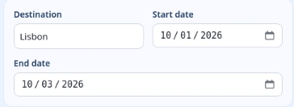
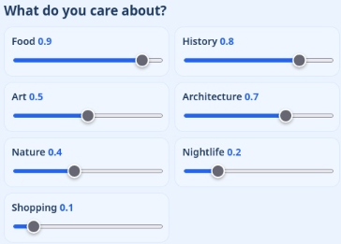
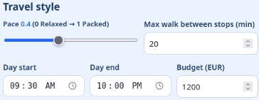

UPDATED
Application Screenshot | Trip Preferences
Actual supplied screenshot, enlarged in sections for readability.
TRIP DETAILS & TRAVEL STYLE
INTERESTS & DIETARY INPUT
Wanderwise | CS-691 | Team F2026-Team4 | Sprint 1
33

Slide 40
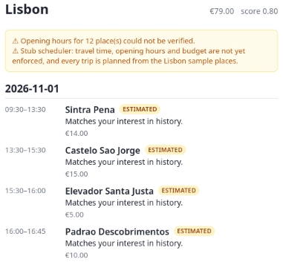
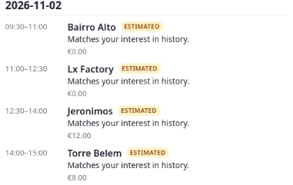
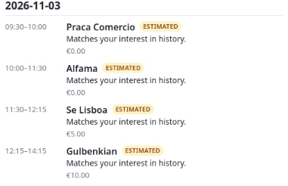
UPDATED
Application Screenshot | Generated Itinerary
Actual Lisbon sample output: daily stops, times, estimated prices, reasons, and warnings.
DAY 1 & WARNING
DAY 2
DAY 3
Current UI uses a stub scheduler: travel time, opening hours, and budget are not yet enforced.
Wanderwise | CS-691 | Team F2026-Team4 | Sprint 1
34

Slide 41
UPDATED
Sprint 1 API | Behaviors to Demonstrate
Reported backend test evidence; show actual request / response details in the live demonstration.
API behavior | Reported test result
Retrieve a saved trip by ID | Returns the saved itinerary — PASS
Reject a place, then re-plan | Updated plan excludes the rejected place — PASS
Reject another place | Earlier and later rejections remain excluded — PASS
Request a missing trip | HTTP 404 — PASS
Send invalid feedback data | HTTP 422 — PASS
Create separate trips | Earlier trip and feedback stay unchanged — PASS
Show the running API’s real route, request, response, trip ID, and status code.
Wanderwise | CS-691 | Team F2026-Team4 | Sprint 1
35

Slide 42
UPDATED
Project Links | Repository & Wiki
Code, sprint artifacts, and supporting documentation.
GitHub Repository
https://github.com/htmw/F2026-Team4
Project Wiki
https://github.com/htmw/F2026-Team4/wiki
Wanderwise | CS-691 | Team F2026-Team4 | Sprint 1
36

Slide 43
UPDATED
Live Application Demo | Sprint 1
Demonstrate the current build honestly; distinguish UI behavior from isolated component tests.
1 Enter a Lisbon trip request
Show destination, dates, interests, and travel limits; make the Lisbon-only boundary explicit.
2 Inspect the generated itinerary
Show days, stops, times, estimated prices, reasons, and the scheduler / opening-hours warnings.
3 Demonstrate persistence and feedback API
Retrieve a saved trip and reject a place using the API if the feedback UI is unfinished.
4 Explain current limitations
The screenshot UI uses sample places and a stub; data / optimizer integration remains in progress.
Wanderwise | CS-691 | Team F2026-Team4 | Sprint 1
37

